Slide 1
ZS Campus Beats 2021 Case Challenge
This document is solely for the use of client personnel. No part of it may be circulated, quoted or reproduced for distribution outside of the client organization without prior written approval of ZS.

Slide 2
Team details
Team Name | Golden Arrows
College Name | Jamia Millia Islamia, New Delhi
Team Leader | Shivank Rastogi
Team Member 2 | Abhishek Chand
Team Member 3 | Areeb Bashir
Team Member 4 | Mohd. Asjad Kamal

Slide 3
scenario Two: Business operations

Slide 4
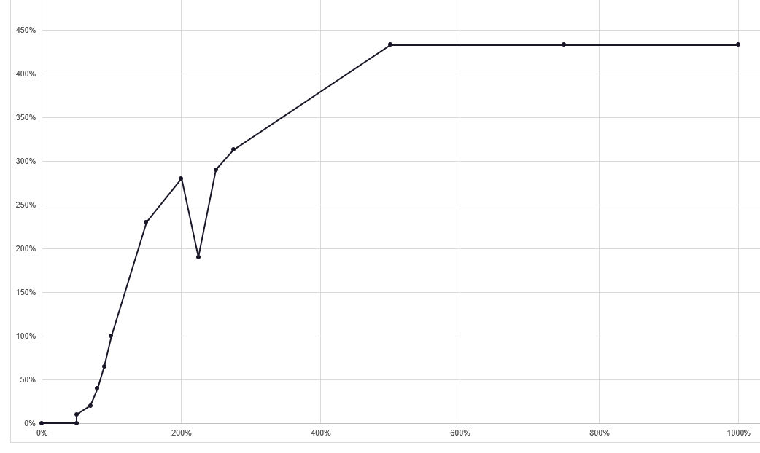
Part 1
Part 2
Part 3
Question: 1.1
Methodology:
Annual Target Pay = Rs1,000,000.
Q-3 Target Pay = (Annual Target Pay)/4
Goal = Target Number of 500 ml bottles Sold.
Attainment % = Number of Unit Sold(in SU)/Goal*100.
Payout/Incentive will be made according to Table-A.
Payout Curve
Payout
Manager | City | Goal(SU) | Sales(SU) | Attainment (%age) | Payout (RS)
Abhishek S | Hyderabad | 250000 | 170650 | 68.2 | 25000
Ankit J | Chennai | 180000 | 98530 | 54.73 | 25000
Kalpana K | Amritsar | 200000 | 182280 | 91.14 | 162500
Kirti S | Goa | 145000 | 125150 | 86.3 | 100000
Kirti S | Coimbatore | 160000 | 180405 | 112.7 | 250000
Rahul S | Gangtok | 235000 | 957165 | 407 | 782500
Rakesh S | Agra | 170000 | 100360 | 59 | 25000
Taran S | Durgapur | 170000 | 137595 | 80.9 | 100000
Ram S | Chandigarh | 225000 | 196635 | 87.3 | 100000
Vishwa P | Mumbai | 190000 | 179125 | 94.27 | 162500
Attainment
Question: 1.2
Assumptions:
It is assumed that Annual Target Pay is uniformly distributed across all the quarters.
Bonuses are calculated according to the Table–A (Attainment v/s Payout Curve).
It is assumed if a regional manager handles more than one city then we have to separately calculate incentive payout according to each city handled
SU: Standard Unit is considered as 500ml

Slide 5
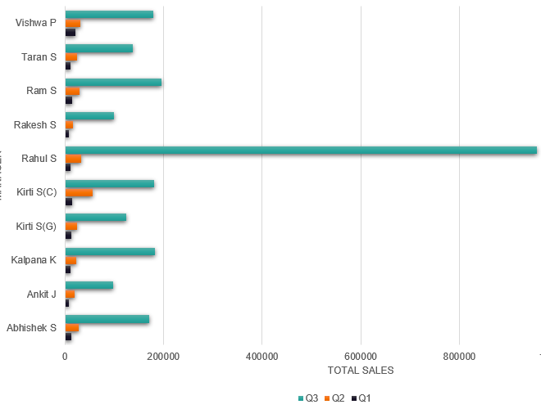
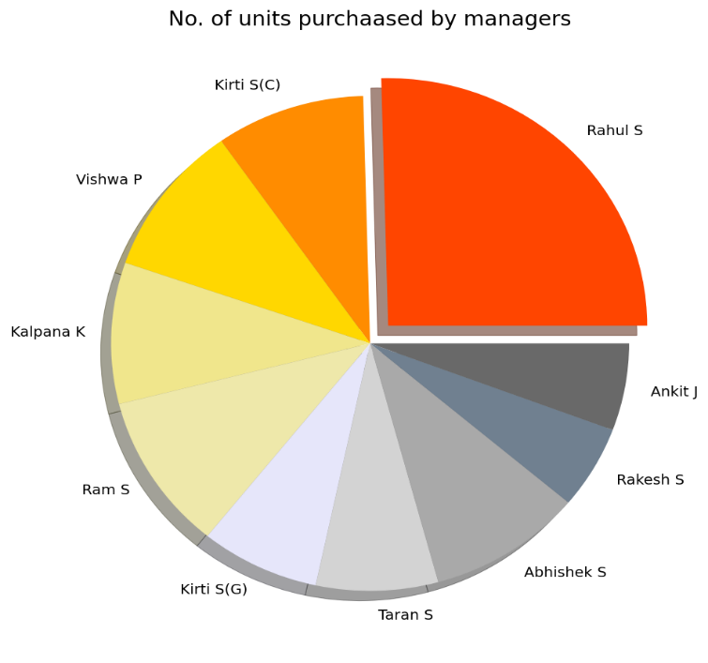
Part 1
Part 2
Part 3
Question: 1.2,1.3
Question: 2.1
Rahul S has the highest payout which is equal to Rs782,500
Total Payout for bottom 3 Manager:
Total Payout = 2082500
Quarterly Sales by each Sales person
Abhishek S = Rs 25,000
Ankit J = Rs 25,000
Rakesh S = Rs 25,000
Total Payout = Rs75,000
Sales( Manager wise)
There is huge disparity between Sales achieved by each sales person in Q1,Q2 and Q3, Sales in Q3 is greater than combined sales in Q1,Q2 combined for all the sales person.
There is huge disparity between Bonus of top performing manager and lowest performing manager, Bonus of top performing manager exceeds bonus of lowest performing manager by 30 times. For example bonus of Rahul S is Rs782,500 whereas bonus earned by Abhishek S is Rs 25,000.
Bonus earned by each manager in Q3 will greater than combined bonus earned by each manager in Q1, Q2.
There is a cap on maximum bonus that can be earned by a Manager, this could be lead to demotivation in high performing managers which can effect their performance

Slide 6
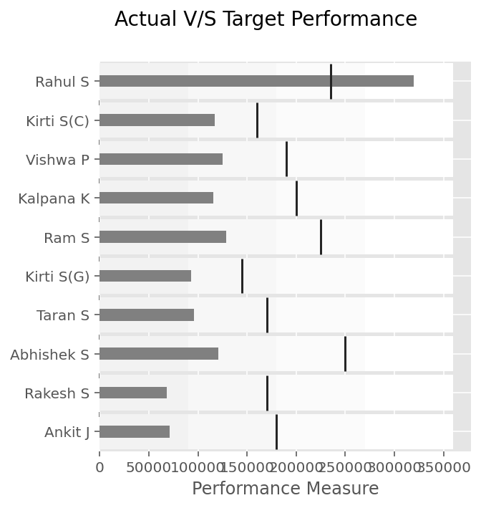
Part 1
Part 2
Part 3
Question: 2.2
Question: 2.3
Target V/S Performance
Methodology:
Sales data for Chennai in dataset is only 85% of the actual data.
Actual Sales Number for Chennai: (Sales Number)*100/85
Actual % of attainment = (Actual Sales Number)/(Goal)*100
Actual Sales Number = 98530*100/85
Actual Sales Number = 115817.65 SU
Sales forecast can be calculated from previous years sales data and Sales target can be computed from the national forecast formulated by the company.
While computing the sales forecast one should always leave some margins for special situations like calamity, wars, disease outbreak.
We should also consider the performance the sales manager with respect to target given to them, For example we can see from the above plot that only one sales manager and no other sales manager was not able achieve their respective target and we can also see more than half of manager have not even achieved their 50% target given to them.
Actual Attainment Percentage = Actual Sales Number/Goal
Actual Attainment Percentage = 115817.65/180000= 64.39
According to Payout vs Attainment
64.39% Attainment lies in 50% bracket hence after getting the actual sales number the payout for Amit does not changes.
Pros of setting Target
Clarity in job objective
Win-Win Situation for employee and employer
Cons of Setting Target
If target are too big then it would lead to demotivation of sales manager which can reduce revenue for the company

Slide 7
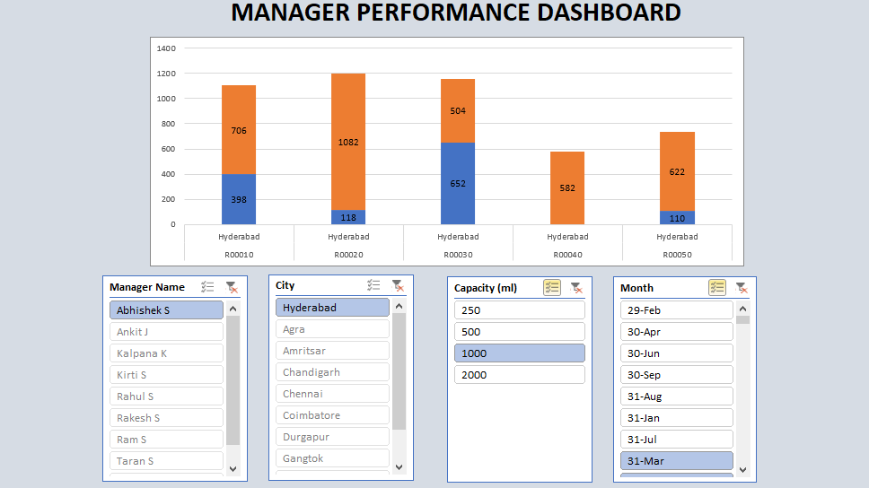
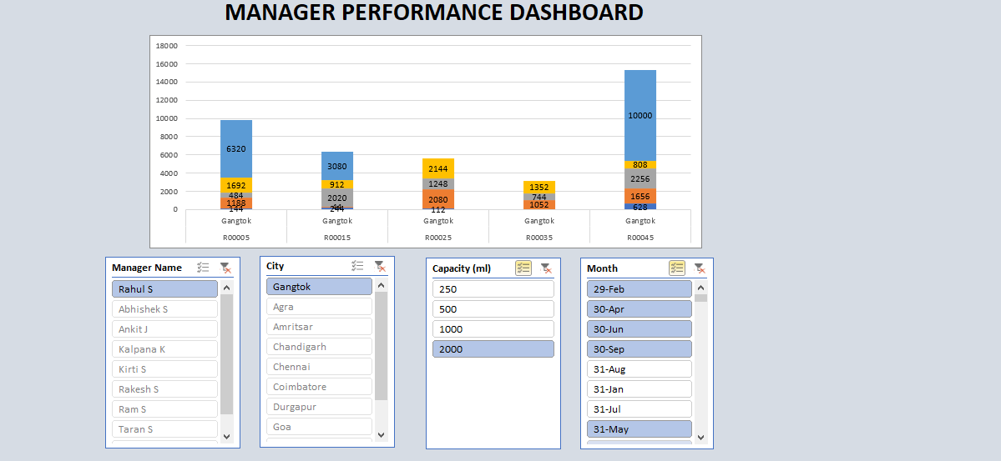
Part 1
Part 2
Part 3
Question: 3.1
We have created an operational dashboard on MS Excel to analyse the performance of each of the managers. Using the dashboard, company’s management can view the sales made by each of the manager in different areas, for different capacity products. Management can also view the manager’s performance across various dates and months
* Excel Workbook with operational dashboard is also submitted in the solution

Slide 8
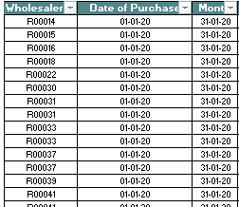
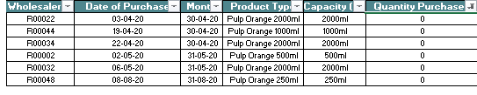
Part 1
Part 2
Part 3
Question: 3.2
Question: 3.3
Advantages of Rank Based compensation System:
Since compensation of sales manager is based upon ranking among peers hence this would increase competition among sales managers and hence sales can increase, so we say that this compensation system should be designed in such a way that it would align the sales person behavior with company's objective.
Sales manager can get rid of unrealistic targets set by the higher authority.
Resources used by the company to forecast sales for the fiscal year and then set target for employees accordingly are saved.
Problem With Rank Based Compensation system :
Unhealthy Rivalry between different sales representatives because of competition, and thus leading to an unhealthy work environment.
There can be huge disparity between bonus received by top performing employee and low performing employee and this could lead to demotivation in workforce.
Company can’t forecast the incentives it need to pay beforehand.
Consideration for Designing Rank Based Compensation system:
The ranking system should be designed such that it can also gauge the hidden action(non-result) efforts made by sales manager so that firm can avoid morale hazard problems
There should be frequent new ranking in a fiscal year so that low performing sales managers can get some motivations.
We can add Filter on Excel for a quick scan for Blanks, Null Values and N.A.
In the dataset, instead of month there are dates
In the dataset, there are valid transactions where quantity purchased is shown as 0
Month attribute does not have data in suiteable format

Slide 9
THANK YOU
Submitted By:
Shivank Rastogi
Abhishek Chand
Areeb Bashir Lone
Mohd. Asjad Kamal

